Slide 1
Temporal Information retrieval
Shrinivas Kane

Slide 2
Agenda
Introduction
Characteristics of temporal data
Types of temporal information
Temporal expressions
Recent Research work
Case study : Learning Recurrent Event Queries for Web Search
My interests
Future work
References

Slide 3
Introduction
What is Temporal Information retrieval?
Why we need it?
What is temporal data?
From where temporal data can be extracted?

Slide 4
Characteristics of temporal data
Well defined
Assuming we know start point and end points relation between two temporal data can be identified easily
Easy to normalize
Temporal data can be normalized with reference to specific semantics in specified format.
Easy to cluster
Hierarchical clustering is possible using level(s) of granularity.

Slide 5
Grouping temporal information
Date
Exact Date
Time
Exact Time
Duration
Time period
Set
Recurrence of event(s).

Slide 6
Temporal Expressions
Implicate
Single or multiples values of this data can be mapped to single
Explicit
Date or time specified explicitly
Relative
Time information in context with other Implicate or explicit expression(s)

Slide 7
Recent research work
Microblogging and real time search
Temporal summaries
Provide snippet based results
Temporal queries
Temporal constraint along with text query.

Slide 8
Case Study : Learning Recurrent Event Queries for Web Search

Slide 9
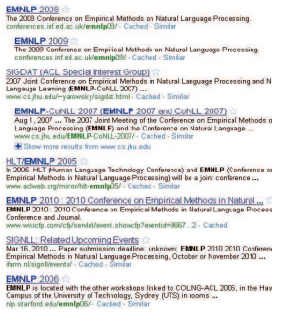
Problem
Classifying queries as recurrent (REQ) and non recurrent(NON-REQ)
queries for event which occur at regular time interval
Re-ranking documents based on temporal data

Slide 10
Feature generation
Extracting time
Used Implicate, explicit and no timestamp queries
Query log analysis
Explicit query ratio
Query reformation
Click log analysis
Search engine result set
Time series analysis
Recurrent event(s) term list

Slide 11
Machine learning approach for Classification of queries
Naive based method
This treats all features are independent
SVM
Gradient boosted decision tree algorithm

Slide 12
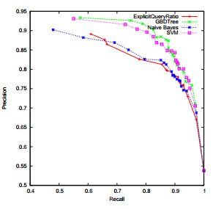
ML evaluation

Slide 13
Re-ranking documents
Page score is boosted if query is REQ
Ranking function
F(q,d) = R(q,d) + [e(d₀,d_{n})+k]e^{λά (q)}
Where R(q,d) base scoring function
λά (q) is confidence score of REQ query
[e(d₀,d_{n})+k]e^{λ} is difference between oldest page and newest page

Slide 14
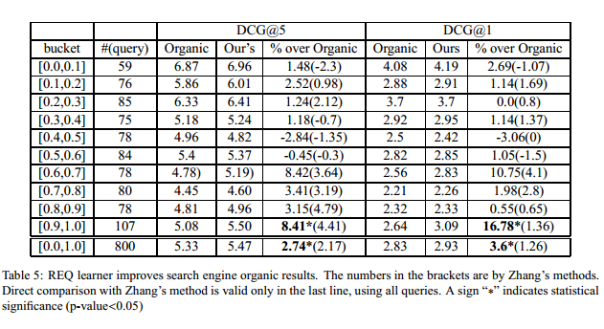
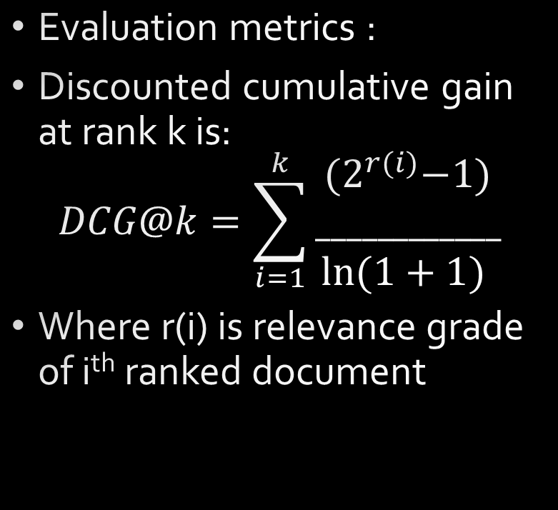
Ranking evaluation
Evaluation metrics :
Discounted cumulative gain at rank k is:
$$DCG@k=\sum_{i=1}^{k}{\begin{aligned}{(2}^{r(i)}−1) \\ ____________ \\ ln⁡(1+1) \end{aligned}}$$
Where r(i) is relevance grade of i^{th} ranked document

Slide 15
My interests
Using machine learning approach to optimize index cache based on temporal query analysis
Plotting Document improvements on timeline

Slide 16
Future Work
How to provide timeline?
How to calculate lifespan of event?
Detecting trending events

Slide 17
References
Ruiqiang Zhang ,Yuki Konda .” Learning Recurrent Event Queries for Web Search”. Oct 11, 2010 - cO2010 Association for Computational Linguistics
James Allan, Rahul Gupta. "Temporal summaries of new topics" 2001 – SIGIR
Omar Alonso , Jannik Strotgen. “ Temporal information retrieval challenges and opportunities ” 2011 – TWAW
J F Allen. “Maintaining knowledge about temporal intervals” communications of ACM 1983
F. Schilder and C Habel “From temporal expressions to temporal information” 2001-TASIP

